Slide 1

ECE 2001 Basic Circuit Theory
Lecture 10
Laplace Transform and Its Application to Circuit Analysis

Slide 2
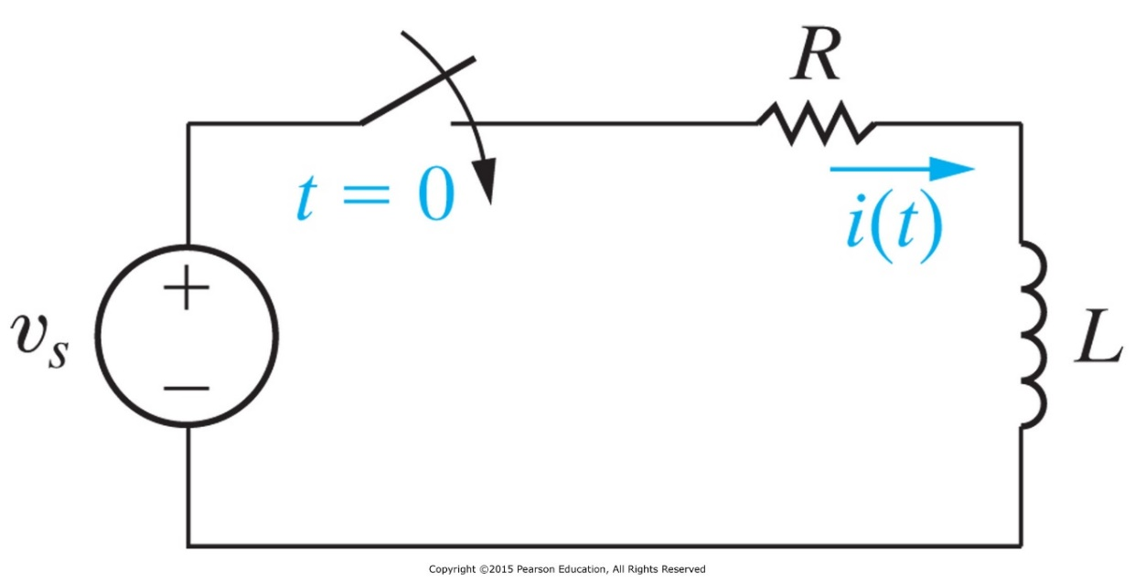
We know how to find the step response of a first-order RL circuit; the key is to solve a homogeneous ODE
Given a DC source v_{s}(t) = V_{m}. Suppose we know that i(t) = I₀ when t <0. Find the current i(t) for t > 0.

Slide 3




However, if the source is given by a cosine function as seen from an AC circuit, the corresponding ODE is difficult to solve.
Given an AC source . Suppose we know that i(t) = 0 when t <0. Find the current i(t) for t > 0.
(When the right-hand side is not a constant, solving the ODE requires advanced mathematical efforts.)
We didn’t discuss how to obtain the following solution that describes the transient state of the current:

Slide 4
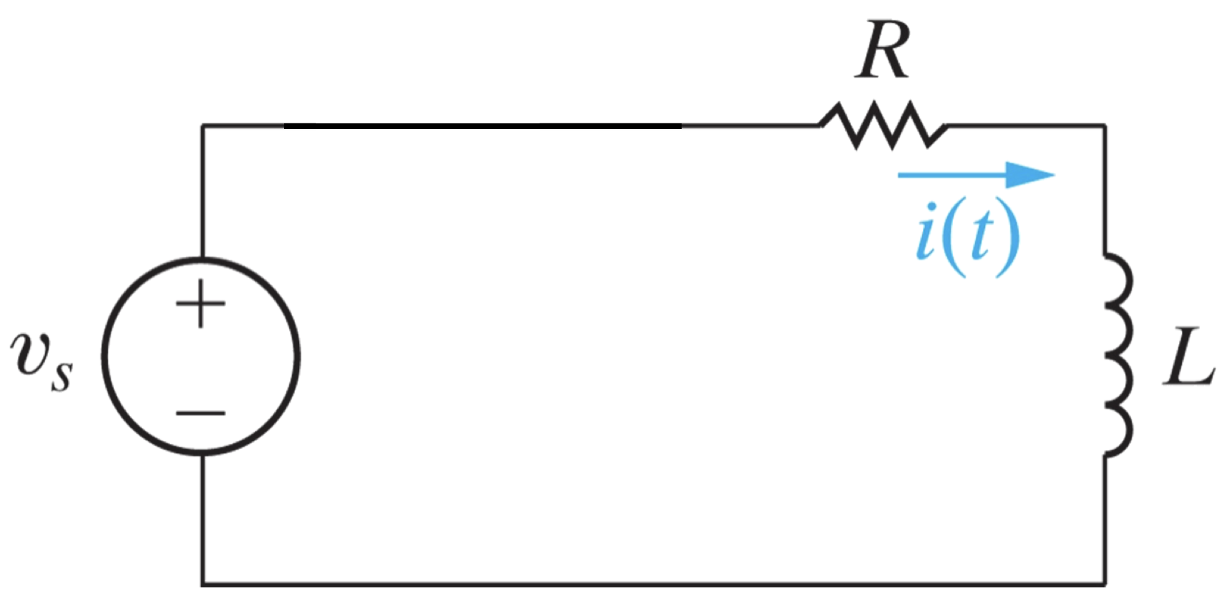
We already learned how to find the steady-state solution using the phasor representation
Given an AC source . Suppose the circuit has been running for a long time. Find the current i(t).

Slide 5
Preview: Laplace transform (LT) can find the step response of AC source (including the transient state).
Given an AC source . Suppose we know that i(t) = 0 when t <0. Find the current i(t) for t > 0.
A preview of the method using Laplace transform (LT)
KVL yields:
LT on both sides (easy to compute):
which solves
Finally, inverse LT (not-so-hard) gives the solution:

Slide 6
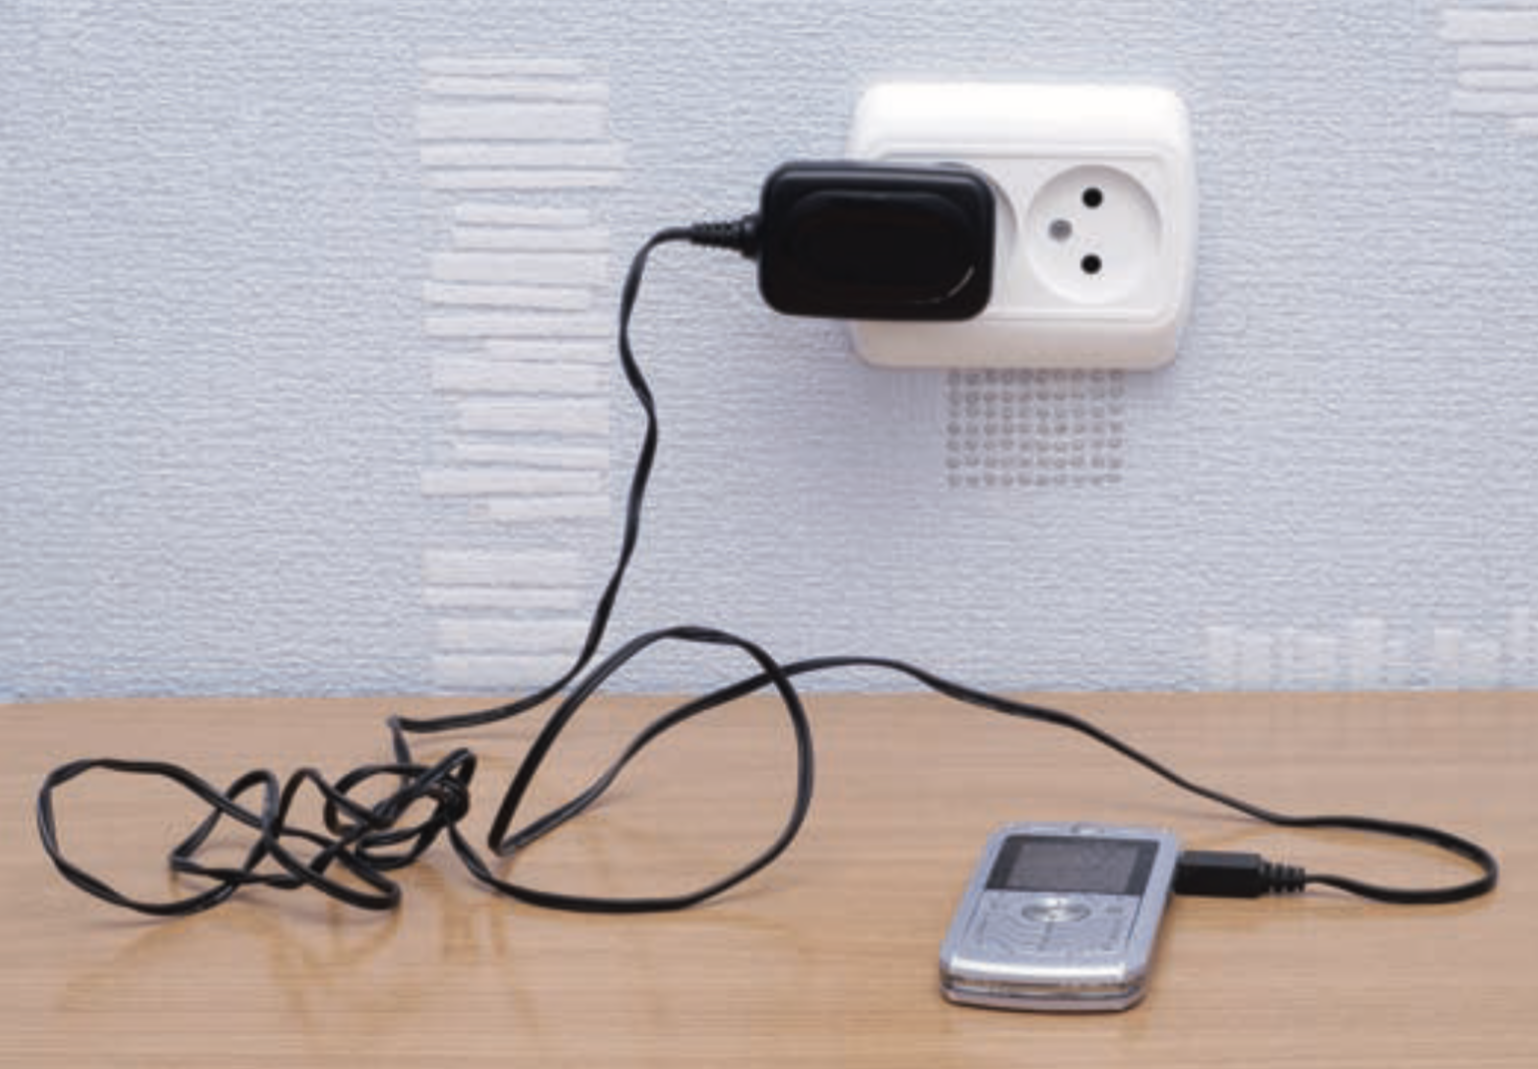
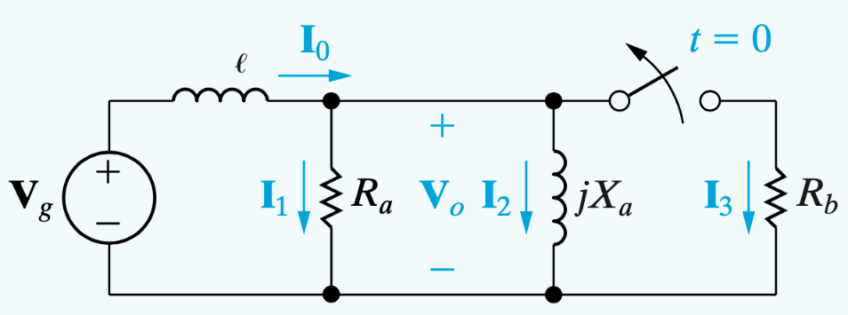

Laplace transformation (LT) overview: Why we should study it?
In short, in many scenarios, we need to understand the transient of a circuit, and the LT provides the tool.
In technical terms, LT can help solve ODEs, handle initial conditions, and simplify the algebra involving differentials and integrals, etc. → Broad applications in industry
(Flipping a switch may cause a so-called voltage surge. We can understand it via LT.)

Slide 7
Overview
Part I. Introduction to LT
  Basics of the LT
  Technique 1: Functional transforms (compute LT via its definition)
  Technique 2: Operational transforms (compute LT via its property)
  Inverse transform
  * Initial- and Final-value theorems
Part II. Apply LT to circuit analysis
  Application to solving ODEs
  Circuit elements in the s-Domain and the analysis
  The transfer function and the concept of impulse response

Slide 8
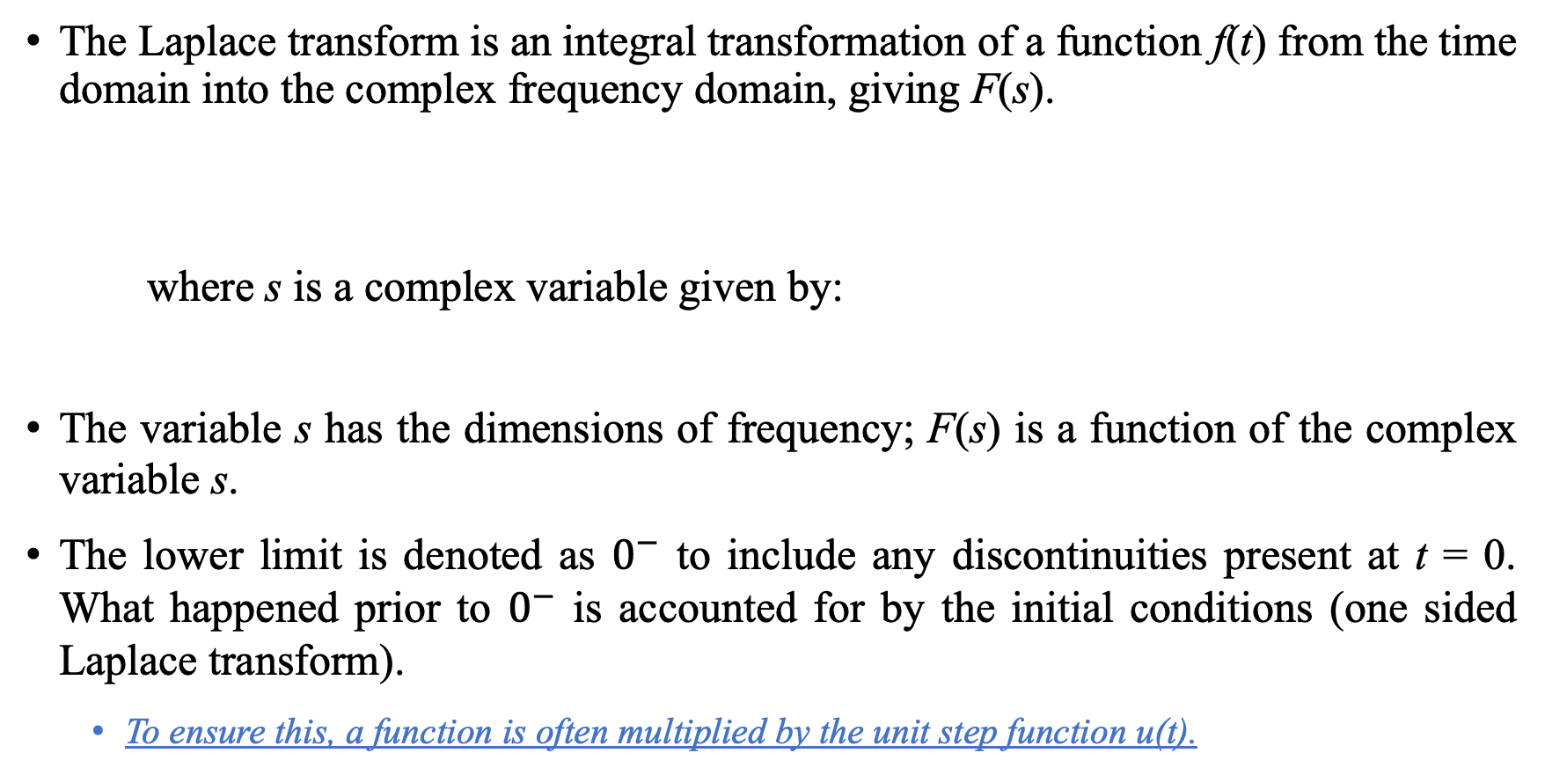
The basics: definition of LT
The Laplace transform is an integral transformation of a function f(t) from the time domain into the complex frequency domain, giving F(s).
where s is a complex variable given by:
The variable s has the dimensions of frequency; F(s) is a function of the complex variable s.
The lower limit is denoted as $0^{−}$ to include any discontinuities present at t = 0. What happened prior to $0^{−}$ is accounted for by the initial conditions (one sided Laplace transform).
  To ensure this, a function is often multiplied by the unit step function u(t).

Slide 9
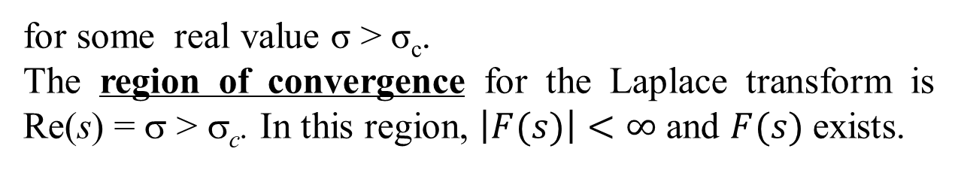
* Existence of Laplace Transform
Not every function has a corresponding Laplace transform function.
For f (t) to have a Laplace transform, the integral must converge to a finite value.
The integral converges when
for some real value σ > σ_{c}.
The region of convergence for the Laplace transform is
Re(s) = σ > σ_{c}. In this region, $\left|F(s)\right|<∞$and $F(s)$ exists.
Fortunately, primary interest in circuit analysis satisfy the above convergence criterion and have Laplace transforms. Therefore, it is not necessary to specify the range in what follows (in this class).

Slide 10
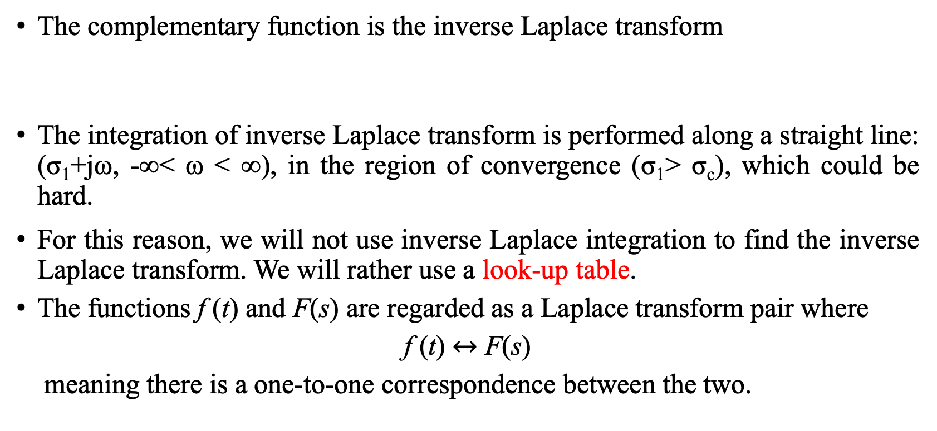
* Inverse Laplace Transform
The complementary function is the inverse Laplace transform
The integration of inverse Laplace transform is performed along a straight line: (σ₁+jω, -∞< ω < ∞), in the region of convergence (σ₁> σ_{c}), which could be hard.
For this reason, we will not use inverse Laplace integration to find the inverse Laplace transform. We will rather use a look-up table.
The functions f (t) and F(s) are regarded as a Laplace transform pair where
f (t) $↔$ F(s)
meaning there is a one-to-one correspondence between the two.

Slide 11
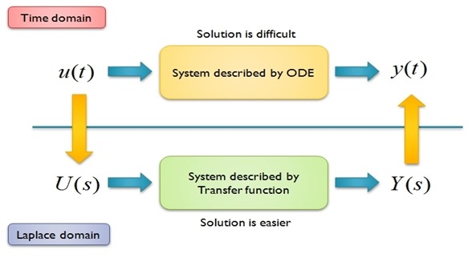
Laplace Transform

Slide 12
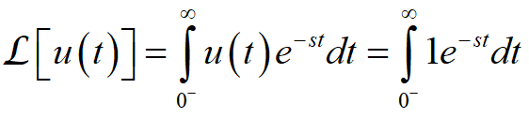
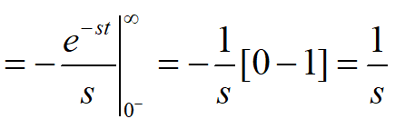

Technique 1: compute LT via its definition, the unit step function
Laplace transform of each of the following functions:
(a) step function $u(t)$

Slide 13


LT for the impulse function
Laplace transform of each of the following functions:
(b) Delta function $δ\left(t\right)$

Slide 14
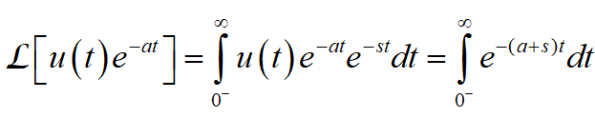
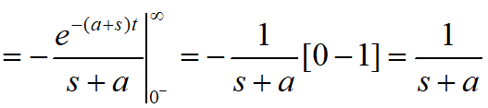

LT for the exponential function
Laplace transform of each of the following functions:
(c) $e^{−at}u(t)$

Slide 15
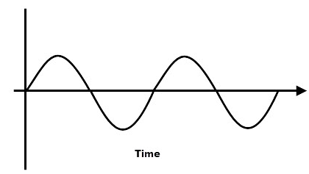
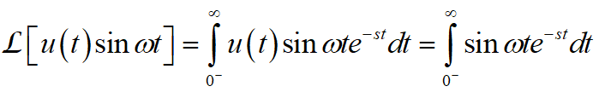
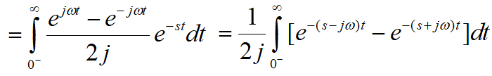
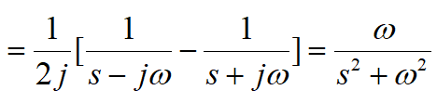
LT for sine
Laplace transform of each of the following functions:
(d) f(t)= u(t)sinωt

Slide 16
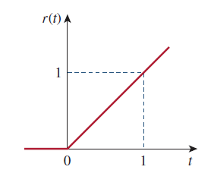
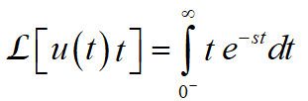
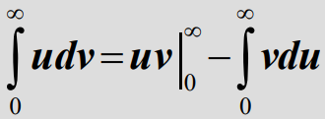
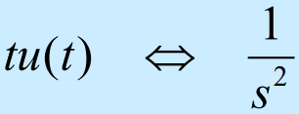
* LT for the ramp function
Laplace transform of each of the following functions:
(e) Ramp function tu(t)
Notes:
Integration by parts

Slide 17
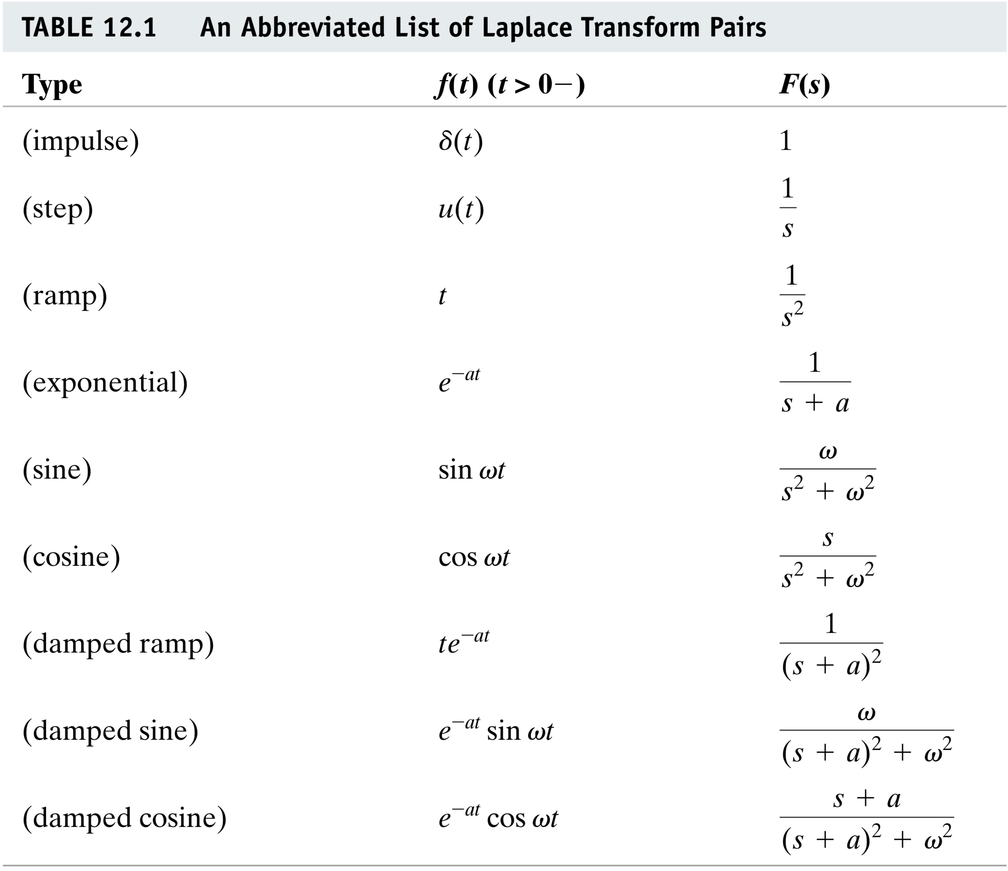

Slide 18
Technique 2: compute LT via its properties
(Properties highlighted in red and boxed in green are required. Other properties are optional. )
Linearity: If F₁(s) and F₂(s) are the transforms of f₁(t) and f₂(t) respectively, then:
Scaling: If F(s) is the transform of f(t)
Time shifting:

Slide 19
Properties of the Transform II
Frequency shift:
Time differentiation:
for the n^{th} derivative:

Slide 20
Properties of the Transform III
Time integration:
Corollary:
more generally,

Slide 21
* Initial and Final Values
It is possible to get the initial value f(0) and final value f(∞) of a function directly from the Laplace transform.
The initial value theorem Final value theorem
Proof:
The IVT is based on the assumption that f(t) contains no impulse functions. The FVT is valid only if the poles of F(s), except for a first-order pole at the origin, lie in the left half of the s plane.

Slide 22
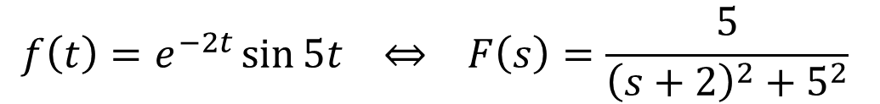

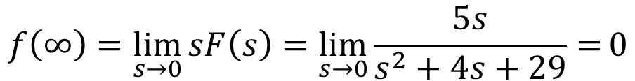

* Example, for t $≥0$
$$f\left(t\right)=e^{−2t}\sin{5t } ⇔ F\left(s\right)=\frac{5}{{\left(s+2\right)}^{2}+5^{2}}$$
Using the initial-value theorem,
Similarly,
which confirms with the value in time-domain $f(t)$.
$$f\left(0\right)=\lim_{s→∞}{sF\left(s\right)=\lim_{s→∞}{\frac{5s}{s^{2}+4s+29}=\lim_{s→∞}{\frac{5}{s+4+29/s}}}}=0$$
$$f\left(∞\right)=\lim_{s→0}{sF\left(s\right)=\lim_{s→0}{\frac{5s}{s^{2}+4s+29}=}}0$$

Slide 23
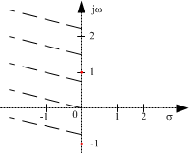
* Validity of FVT – an example
Consider the Laplace pair:
Applying the final value theorem
But for t >0, oscillates between -1 and 1, it does not have a limit.
Poles of F(s) is at s = ±j, which are not in the left s plane (they are on the imaginary axis).
In general, the final value theorem does not apply in finding the final values of sinusoidal functions—these functions oscillate forever and do not have final values.

Slide 24
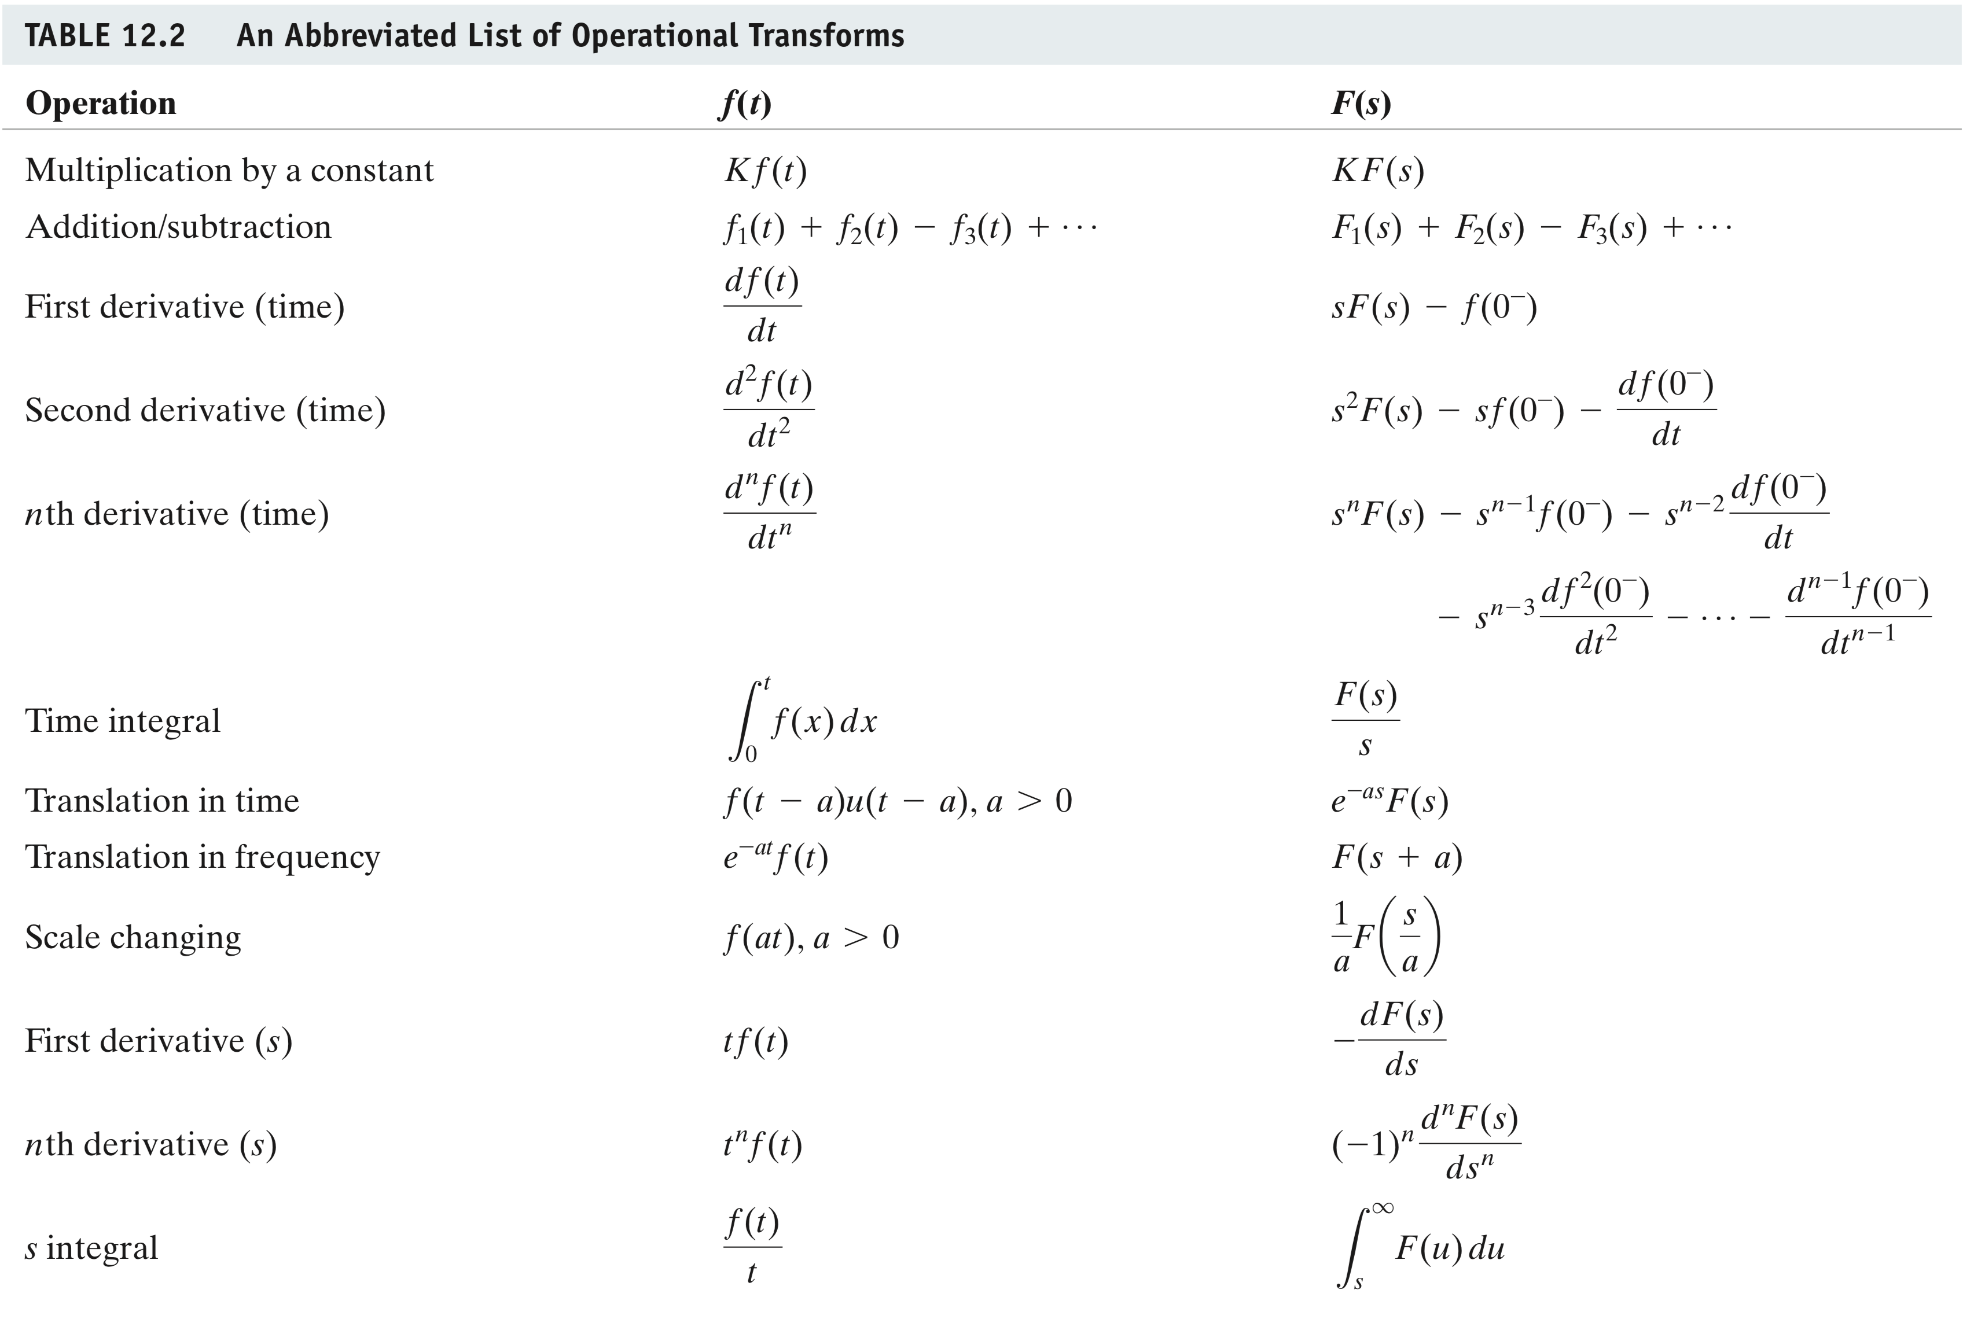

Slide 25

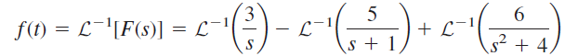


Inverse Laplace Transform
Method 1: By inspection, i.e., table look-up
Method 2: By partial fraction expansion
Example: find the inverse Laplace transform of
Recall:
The inverse transform is given by
By checking the transformation pairs,

Slide 26
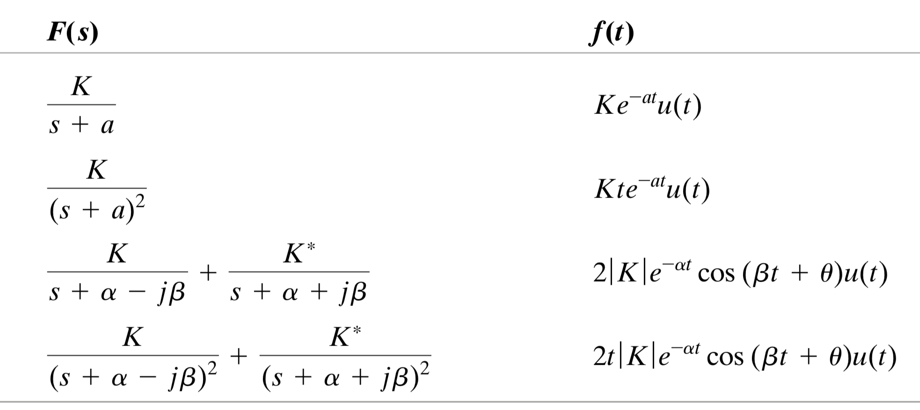
Method 1 Table lookup:
Frequently used transform pairs
u(t)
u(t)
* Note: we focus on right-sided functions, i.e., pay attention to the unit step function u(t) in the table. Equivalently, you can also emphasize that the expression f(t) is for t > 0.

Slide 27
Method 2: Partial fraction expansion
You usually need to factorize and expand F(s) before you can apply table lookup
Example: Consider
  Step 1: Factorize the denominator
  Step 2: Convert to an expansion
  Step 3: Inspection
  Finally
Remark: the region of convergence “Re{s}>-1” is something you need to consider for a rigorous Laplace transform. Yet, for our course, you don’t need to worry about that.

Slide 28

General discussion: A systematic method for partial fraction expansion
In general, the expression for F(s) is in forms of rational function of s. A rational function can be defined by a rational fraction, i.e. an algebraic fraction such that both the numerator N(s) and the denominator D(s) are polynomials.

Slide 29
There are 4 possible cases for factorizing the denominator term D(s)
  Distinct Real Roots of D(s)
  Repeated Real Roots of D(s)
  Complex Roots of D(s)
  Improper rational function
Note: The ratio N(s)/D(s) is called a proper rational function if m>n, and an improper rational function if m ≤ n.

Slide 30
Case 1: D(s) has distinct real roots
Note: some books use –p_{j} instead of the +p_{j} . It does not affect the definition of poles.
it can be expressed as:
Where s=-p₁, -p₂,…,-p_{n} are distinct simple roots i.e., p_{j} ≠ p_{k} for all j ≠ k.
This can be expanded as:
where k₁, k₂,…k_{n} are the residues of F(s).
To have partial fraction decomposition
  Apply the residue method
  Apply the algebraic method

Slide 31




Case 1: D(s) has distinct real roots
According to the table of inverse Laplace transform:
Yielding:
Example:
Solution: There are three distinct real poles, so we let

Slide 32
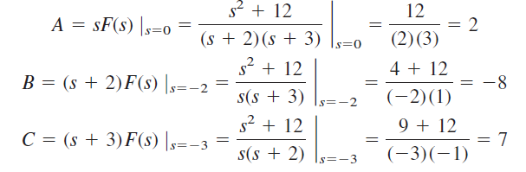
Example using the residual method
Residue Method

Slide 33
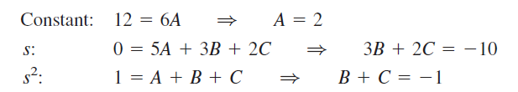
Example using the algebraic method
Algebraic Method – reduction of fractions

Slide 34
Case 2: D(s) has repeated real roots
If F(s) has n repeated poles at s=-p, then decompose the fractions as:
where G(s) is the remaining part of F(s) that does not have a pole at s=-p.
The expansion coefficient is obtained from
Also
Apply the inverse transform,
The transform will be:
xt
where

Slide 35

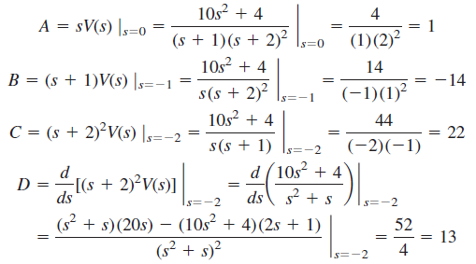

Example
Residue Method

Slide 36

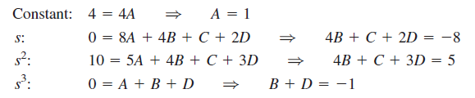
Example
Algebraic Method

Slide 37
Case 3: D(s) has complex roots
Handling complex poles can be done by using the same techniques for real poles. There can be distinct and repeated complex poles as well.
One thing to note that N(s) and D(s) always have real coefficients.
Complex roots of polynomials with real coefficients must occur in conjugate pairs.
So here we can use a technique called “completing the square”
To rewrite F(s) as a general form below:
where F₁(s) is the remaining part that does not have this complex conjugate pair.

Slide 38



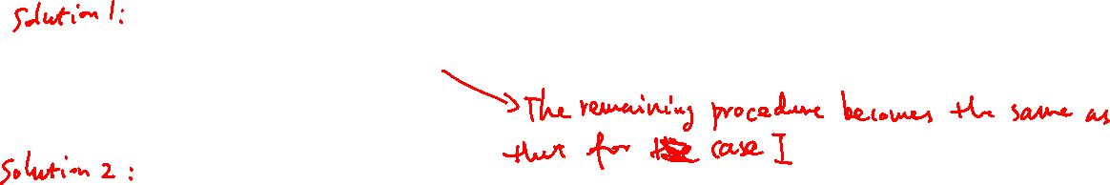
(Property: For complex root case, the coefficient must be complex conjugate)
A trick to easily handle the complex root case
Completing the square by letting
Also let
Then
So the inverse transform is
Note: sin and cos terms can be further combined if needed.

Slide 39
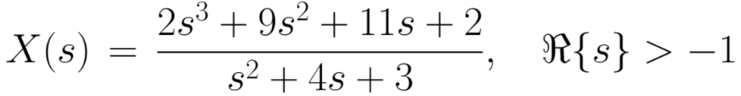
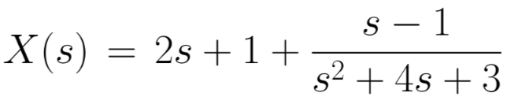









Case 4: Improper function. The order of the numerator polynomial N(s) is higher than that of D(s)
Example 1: One can expand using long division to obtain
Example 2:
$$δ\left(t\right)⟺1$$
$$\frac{dδ\left(t\right)}{dt}⟺s$$
$$\frac{d^{2}δ\left(t\right)}{dt^{2}}⟺s^{2}$$
$$⟺$$

Slide 40
Example (Residue method)
Find the inverse transform of the frequency-domain function
Residue method
Note: for the complex pair of roots, only one k needs to be determined!

Slide 41
Example (Residue method)
Taking the inverse Laplace transform of H(s),

Slide 42
Example (Algebraic method)
Express H(s) in terms of partial fractions
The equation must be satisfied for all values of s.
Sub 3 convenient s values that are not poles of H(s), e.g s=0, s=1 and s=-1.
Solve for A, B & C:

Slide 43
Example(Algebraic method)
Completing the square
Taking the inverse Laplace transform of H(s),
same result as before.

Slide 44


Application: Solving ODEs using Laplace transform
The Laplace transform is useful in solving linear integro-differential equations.
Using the differential and integral properties of Laplace transforms, each term in the equation is transformed.
Initial conditions are automatically taken into account.
The resulting algebraic equation is solved in the s-domain.
The s-domain solution is then converted back to time domain by using the inverse transform.

Slide 45





Example
Solve the equation, subject to the initial conditions:
Take the Laplace transform of each term of the differential equation
Determine the coefficients of the partial fractions

Slide 46
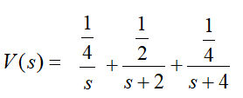

Example
Recall the transformation pair
$$e^{−at} ⟺ \frac{1}{s+a}$$

Slide 47

Example: solve
Solve the integro-differential equation subject to the condition y(0)=2
Set s= 0 and 1,
Solve for A, B, , and obtain
Inverse Laplace transform

Slide 48

Laplace transform applied to circuit analysis
So we can apply the Laplace transform to circuit analysis.
Three Steps as usual ~
  Transform the circuit from time domain to the s-domain.
  Solve the circuit using nodal analysis, mesh analysis, source transformation, superposition, or any circuit analysis technique with which we are familiar.
  Take the inverse transform of the solution and thus obtain the solution in the time domain.

Slide 49
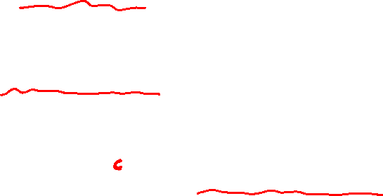
Circuit Element Models
As was done in phasor analysis, we transform a circuit from time domain to the frequency or s-domain.
For a resistor, the voltage current relationship in the time domain is:
Taking the Laplace transform:
For an inductor,
Taking the Laplace Transform:
For a Capacitor
Taking the Laplace Transform:
(minus)

Slide 50
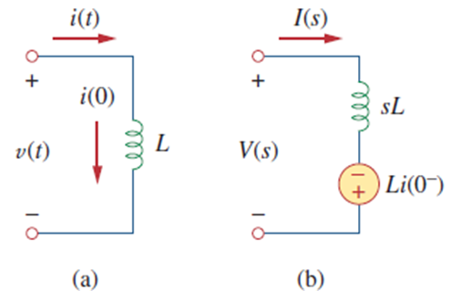
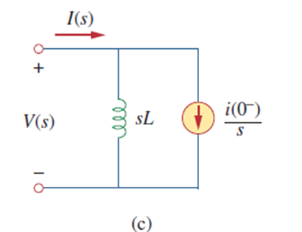
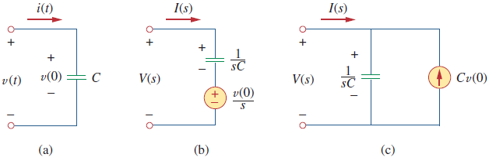
Equivalent Circuit in s-domain
Here are the equivalent circuit elements including the sources for the initial conditions.
Note the initial conditions can be represented either as a voltage in series or as a current source in parallel. Watch out for the signs of the voltage/current.
Inductors
Capacitors

Slide 51
*Magnetic coupled Inductors
In t-domain
In s-domain
Similar equivalent circuits apply to other dot arrangements (watch out for the sign of M)

Slide 52
Impedances and Admittances
Similarly, we can define the impedance in the s-domain as:
Thus, the three elements will have the following impedances:
In the s-domain, the admittance is also simply the reciprocal of the impedance:

Slide 53
Dependent Sources
The models for dependent sources and op-amps are also easy to develop.
Dependent sources have a linear output based on the input.
In the Laplace transform, multiplying the time-domain equation by a constant results in the same constant multiplied against the Laplace transform (linearity).
Ideal Op amps: they just multiply a voltage by a constant. Thus, we can derive the equations as per normal, taking the input voltage to be zero and input currents to be zero for an ideal op-amp in linear mode.

Slide 54
Circuit Analysis
Circuit analysis is again relatively easy to do when we are in the s-domain.
The exciting thing about this is that ALL of the circuit theorems and relationships we developed for dc circuits are perfectly valid in the s-domain.
One significant advantage of the Laplace transform is that it includes both stead-state and initial conditions.
This allows for obtaining both the steady-state response as well as the transient response.
But Remember, equivalent circuits, with capacitors and inductors, only exist in the s-domain; they (initial conditions) cannot be directly mapped back into the time domain.

Slide 55
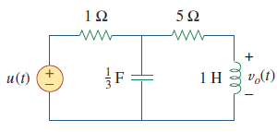
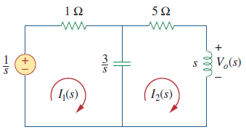
Example 1
Find v_{o}(t) in the circuit, assuming zero initial conditions.
Laplace transforms:
Mesh analysis of s-domain circuit
Completing the square:
Take the inverse Laplace transform
t-domain
s-domain

Slide 56

Example 2
Find v_{o}(t) in the circuit. Assume v_{o}(0)=5 V.
Laplace transforms
Nodal analysis
t-domain
s-domain

Slide 57
Example 3
The switch in the circuit moves from position a to
position b at t=0, find i(t) for t>0.
Initial condition i(t)=I₀.
Laplace transform
Mesh analysis
Expansion:

Slide 58

Example 3
Inverse Laplace transform
In terms of the characteristic time constant τ=L/R
The second term is the transient response. In the case I₀=0 (no initial energy), the response is to a step input voltage
The first term is the steady state response, which may also be obtained from the Laplace transform I(s) by applying the final value theorem.

Slide 59
Example 4
Assume that there is no initial energy stored in the circuit at t=0 and that i_{s} = 10u(t). Find V_{o}(s) using Thevenin’s theorem and hence v_{o}(t)
To find V_{Th} , consider the Laplace transformed circuit (a)
Note: the current controlled voltage source in the s-domain is just 2I_{x}(s).
At open circuit, I_{x}=0, the open circuit voltage is

Slide 60
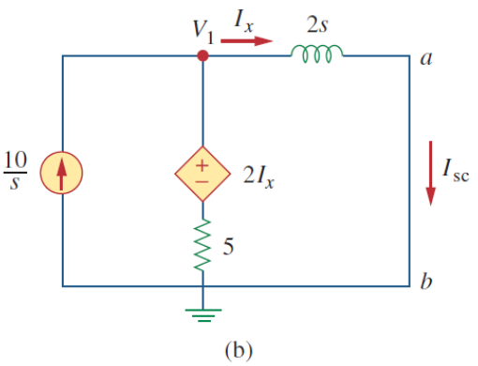
Example 4
To find the short circuit current, consider (b).
The equivalent impedance is thus
Recall the original circuit, the output voltage is across the 5Ω load, the circuit is equivalent to (c).
i_{x}
(c)

Slide 61


Example 4
Partial fractional expansion,
Determine A & B：
s-domain voltage across the 5 Ω resistor is
The corresponding t-domain voltage is
Note
which agree with the results obtain through initial- and final-value theorems
Initial- and final-value theorem imply:
Notes:
final-value theorem

Slide 62
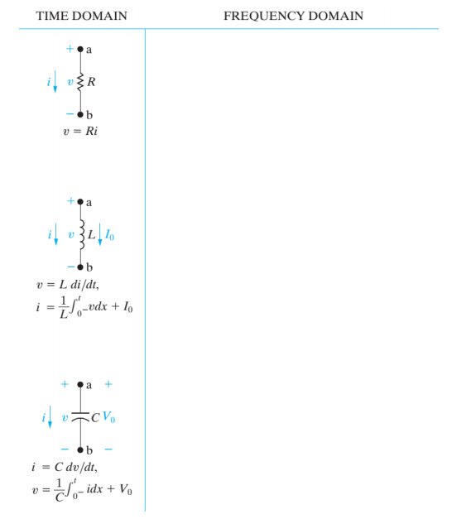
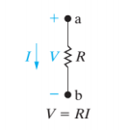
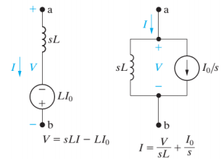
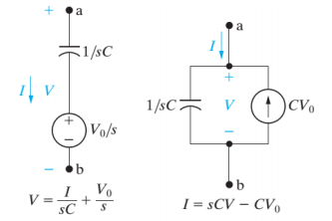
Summary of equivalent circuits in the s-domain

Slide 63


Transfer Function and Impulse Response
Previously we have talked about the transfer functions in frequency response.
The transfer function is a key concept in signal processing because it indicates how a signal is processed as it passes through a network.
The transfer function relates the output of a circuit to a given input, assuming zero initial conditions.
  The transfer function of the circuit is the system response Y(s) to a unit impulse input X(s) = 1. In other words, in the time domain, h(t) = y(t) if x(t) =$δ\left(t\right).$
  Here, h(t) is called the impulse response function of the circuit (or system).
$$H\left(s\right)=\frac{Y\left(s\right)}{X\left(s\right)}$$

Slide 64

Example
Determine the transfer function $H\left(s\right)=\frac{V_{o}(s)}{I_{o}(s)}$ of the circuit.
Method 1 (current division)
Method 2 (ladder), let $V_{o}$=1V.
V₁

Slide 65
Expected learning outcome
Be able to compute the (one-sided) Laplace transform for several basic functions (e.g., Table 12.1 on Page 16) using direct integrals and/or the Laplace transform properties
Be able to compute the inverse Laplace transform using table loop-up methods and partial fraction expansion
Be able to apply Laplace transform for circuit/system analysis (and synthesis)
  Be able to understand the equivalent circuit elements in the s-domain
  Have some basic understanding for the concept of transfer function H(s) (in the s-domain) and the impulse response function h(t) (in the time domain), and the fact that h(t) is the inverse LT of H(s).

